Slide 1
THE ICEKRUSHER TOOL
NOVA PATH CREATIONS LLC
Charles James Dashiell III, CEO
chuck@icekrusher.com
908-463-1775

Slide 2
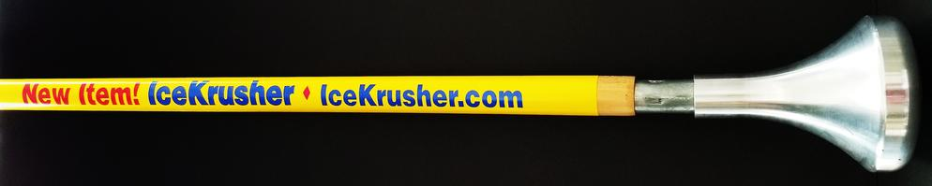
The IceKrusher Tool-
Surface Ice Dislodger and Soil Tamper-PATENT PENDING 31 MARCH 2018

Slide 3
Problem/Opportunity
Ice accumulates on walking surfaces constantly, often overnight, presenting early morning safety hazards
Salt and other melting agents can have negative effects on the environment
Tools commonly used to remove ice tend to scratch and damage many surfaces

Slide 4
Value proposition
The IceKrusher tool cracks ice and frozen snow on walking and driving surfaces with a simple gravity based motion
IceKrusher prevents damage to surfaces and reduces the amount of salt and other melting agents needed for safe passage
Easy to use, easy to store, saves money, helps prevent injuries and exposure to claims
IceKrusher has year-round use for the landscaping and fence installation markets

Slide 5
Underlying Magic
The IceKrusher head looks exactly like a standard floodlight bulb. Weighing just three pounds of cast
aluminum, it attaches to a 48 inch wooden handle with a male threaded tip. Naturally balanced.
Simple lifting and dropping of the convex(curved) tool head on accumulated surface ice causes radial cracking and dislodgement of ice without chipping or scratching. The shape is the key.
Reduces amounts of salt and chemicals needed for safety. The ice safety market is trending green, and the IceKrusher fits perfectly

Slide 6
Business Model
To be manufactured in and distributed from Cincinnati, Ohio which is less than 4 hours flying time from 60% of the US population
Direct to consumer model via Icekrusher.com
Several major bulk distributors including Grainger located within two truck hours of Cincinnati fulfillment center
No retail outlet component first 18 months-on-line sales have stronger margins

Slide 7
Go-To-Market Plan
September 2020- build 300 units in Paterson NJ (hand made at machine shop) for fall marketing efforts at local street fairs (100 units); TV weather station promotion in cold cities (50 units) and trade show floor stock(150 units)
September-December 2020 during 12-week mold build, put marketing plans in action with focus on SEO. Attend Made In America trade show in October*-take hard orders for Winter 2020 at show from 2018 leads and new contacts

Slide 8
Competitive Analysis
Competing product is the standard flat-blade roof scraper tool. Does not perform in a similar manner to IceKrusher, but is less expensive and the common option
Competitive issue is the market’s ignorance of an option to the blade chipper
NPC marketing plan addresses the IceKrusher benefits of reduced salt use and surface damage, multiple uses as a counter to the scraper’s price

Slide 9
Management Team
Charles James Dashiell III, CEO and Technology Head-26 years Air and Ground logistics sales and management experience; 10 years wireless technology sales experience.
Mitchell Cohen, Finance Director- 32 years Accounting, Finance and Audit experience
Nicole Maron, Marketing Director- 25 years brand management, trade show and graphic design experience

Slide 10
Current Status and Accomplishments to Date
Currently sourcing $250,000 for head mold purchase(capacity 5,000 units per week); fulfillment center set-up; inventory of 3000 units; 2020 tradeshow expense and general operations for 2021(Garwood NJ sales office and marketing travel)
Selected by thegrommet.com for Winter 2018, November 2018-they are waiting for our production date, and are owned by Ace Hardware; they have a pathway-to-store program for successful products
Successful trial at Preferred Freezer Systems in Jersey City yielded purchase order, March 2019. 35 locations nationwide and a WARM WEATHER USER

Slide 11
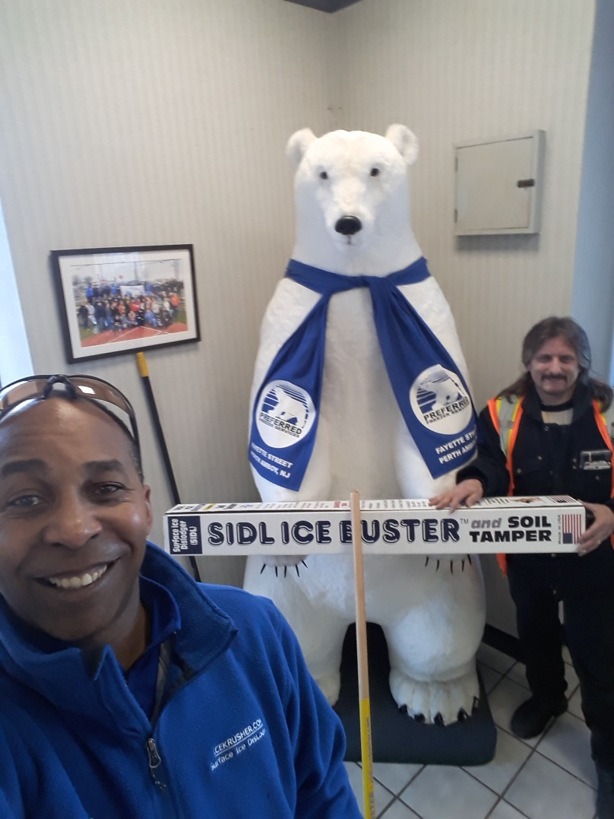
FIRST COMMERCIAL DELIVERY OF THE ICEKRUSHER,3/19/19- PREFFERED FREEZER SYSTEMS, PERTH AMBOY NJ

